Slide 1

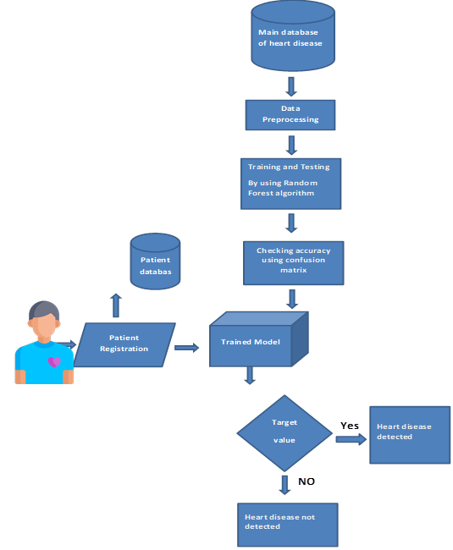
Dr .D .Y. Patil Institute of Technology, Pimpri,Pune-18 Department of Artificial Intelligence and Data Science Engineering
Title : Heart Disease Prediction System
Abstract
Disease prediction using machine learning is a system where diseases are predicted by the machine learning algorithm on the basis of the symptoms provided by the user. In this project we will be collecting datasets, manipulate them and use machine learning algorithms to create system that will efficiently predict the disease the user is suffering from on the basis of symptoms he/she possesses.
System Architecture
Conclusion
Hence, we proposed a method for heart disease prediction using machine learning techniques, these results showed a great accuracy standard for producing a better estimation result. By introducing new proposed Random forest classification, we find the problem of prediction rate without equipment and propose an approach to estimate the heart rate and condition.
Objective
Good data-driven systems for predicting heart diseases can improve the entire research and prevention process, making sure that more people can live healthy lives
Group Members
Group 11
Applications
Increased accuracy for effective heart disease diagnosis.
Handles roughest(enormous) amount of data using random forest algorithm and feature selection.
Reduce the time complexity of doctors.
Cost effective for patients.
1.SAI&D02 Prathamesh Patil 2.SAI&D07 Ganesh Jagzap 3.SAI&D08 Jay Sawant 4.SAI&D09 Atharv Wankhede

